Slide 1
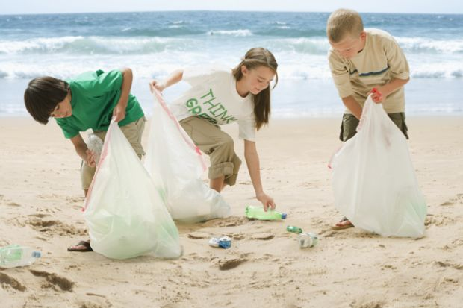
TAKE ACTION!
In the News

Slide 2
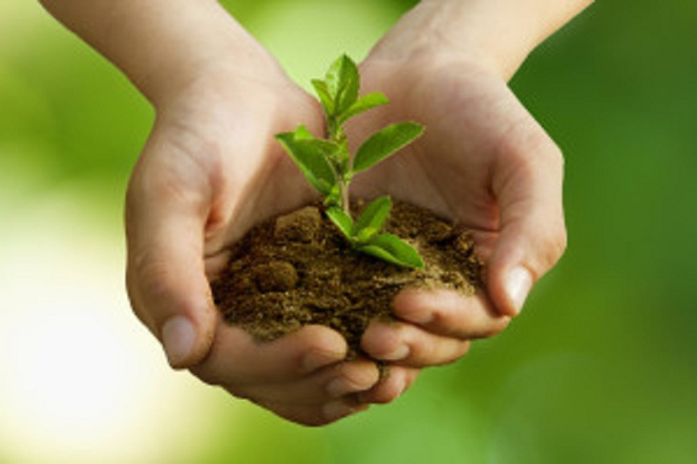
The Nature Madness Club
Summary of the events
The facts in detail
Comments

Slide 3
Mayor honours teens for green work
come up with an idea (exp) - get an idea
member (n) - a person who belongs to a club/ team
word soon got around (exp) - people heard about it
ask for (exp) - request
take part in (exp) - do something in a group
pollution (n) – the process of making air, water and soil dirty
conservation (n) - keeping things in good condition
stray (adj) - without a home
mayor (n) - the leader of a town
ceremony (n) - a formal event
proud (adj) - pleased about sth you own or have done
grown up - adult

Slide 4
Football finals
People: fans
Place/ time: all over the country
Highlights: Rovers beat the Reds 3:1
Atmosphere: happy, exciting
Fans are celebrating all over the country after Rovers beat the Reds, 3 goals to one.

Slide 5
A pop concert
People: thousands of fans
Place/ time: before a concert
Highlights: a fantastic show
Atmosphere: amazing, exciting
Thousands of fans are expecting to see a fantastic show by their favourite band.

Slide 6
A fashion show
People: the audience
Place/ time: at a fashion show
Highlights: this year’s collection
Atmosphere: happy
The audience loves this year’s collection presented at the fashion show.

Slide 7
A demonstration
People: the locals
Place/ time: in front of the Mayor’s offices
Highlights: closing down of the town swimming pool
Atmosphere: angry
The locals are in front of the Mayor’s offices demonstrating against the decision to close down the town swimming pool.

Slide 8
HOMEWORK
Выписать и выучить слова SB ex.1 p.40
WB ex.1,2,3,4 p.25
* SB ex.5 p.40

